Slide 1
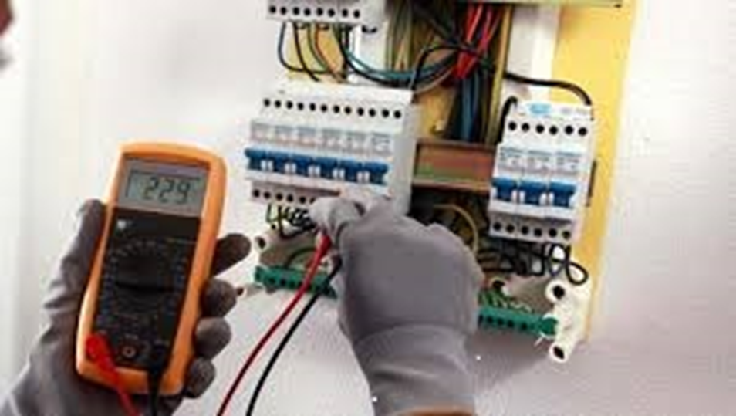
Maintenance Year 3&4
Electricity

Slide 2
Electricity.
Lesson objectives
At the end of the lesson learners should be able :
1. To understand the overview of Electricity.
2. Name or identify hand and power tools.
3. To know the uses of hand and power tools.
4. To know different types of lights.
5. To understand advantages and disadvantages of different lights.
6. To know loadshedding.

Slide 3
Overview of electricity
Definition: it the of electric current through a conductor.
Types of electricity
1.Current electricity: It is the rate of flow electrons.
Kinds of current electricity
Direct Current(D.C) – Energy one gets from the battery.
Alternating Current(A.C) – Energy one gets on the plugs on the
walls.
2. Static electricity: It is when electrical charges build up on the surface of the material.

Slide 4
Basic safety rules in Electricity.
1. Use SABS approved electrical wires or cords.
2. Do not use electrical tools with worn or damaged wires.
3. Do not touch electrical machines or tools with wet hands or barefoot.
4. Switch off and unplug after use all power hand tools.
5. Do not open the distribution box(DB) in the workshop.
6. Learners should not play with electrical sockets.
7. Do not pull the plugs by cord.
8. Do not attempt to repair electrical machines or tools.
9. No overloading of plugs.
10. Never put bare wires into sockets.
Feedback
Activity : Worksheet 1

